Slide 1
Business Economics
Marcelo Ortiz M.
Fall 2021

Slide 2
Topic 9: Corporate Ownership and Governance
So far, we have discuss how to improve the relative efficiency of an organization.
  - Two theoretical frameworks: (1) Transaction Costs and (2) Principal-Agent model.
  - Agents’ decision right allocation, performance evaluation, compensations.
  - Firm scope: integration and outsourcing.
Today, we will continue this discussion but with a focus on how the firm’s ownership structure affects its relative efficiency.
  - big difference: this structure is a market outcome, not part of managerial design.
  - equilibrium in the market for corporate control.

Slide 3
1) Property Rights of Corporations and Blockholders
Private property:
  - Ownership rights (decision-making authority) and wealth effects (benefits or losses from decisions).
  - Alienability (transferability) ensures resources are managed by individuals best positioned to maximize their value.
  - This principle applies to corporate ownership, where shareholders can sell their stakes to more capable decision-makers if needed.

Slide 4
1) Property Rights of Corporations and Blockholders
Unlike private company managed by a sole owner, public corporations often involve diffuse ownership:
  1) Decision right delegation to managers
  2) Where no single shareholder has sufficient incentive or authority to monitor management effectively.
Agency costs arise when decision rights are delegated, as managers (agents) may act in their own interest rather than for shareholders (principals).

Slide 5
1) Property Rights of Corporations and Blockholders
This problem get worse if ownership is more diluted:
  In diffuse ownership structures, shareholders face a free-rider problem:
    - any individual shareholder bears the cost of monitoring
    - while only sharing a fraction of the benefits.
Numerical example: personal cost of monitoring $100, increased net income for monitoring, $200. The monitoring shareholder owns 20% of the shares.
  - Individual benefits: 20% x $200=$40.
  - Individual cost: $100
  - Notice the trade-off: the larger the % of ownership, more incentives to monitor

Slide 6
1) Property Rights of Corporations and Blockholders
Blockholders are large shareholders who maintain a significant ownership stake (5%, 10%, or more), enabling them to exert governance influence.
Their presence ensures at least partial alignment of decision rights and wealth effects, mitigating agency costs.
Blockholders can provide direct oversight of management, including electing directors and influencing major decisions (“voice”), or exert influence through the potential sale of their stakes ("exit").

Slide 7
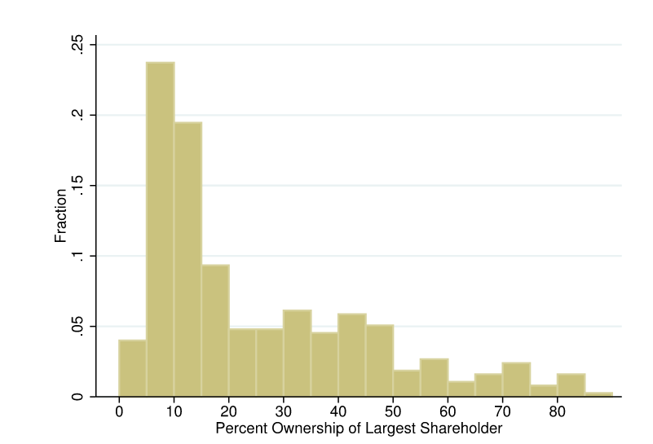
1) Property Rights of Corporations and Blockholders
Ownership shares
(Edmans et al., 2017 )

Slide 8
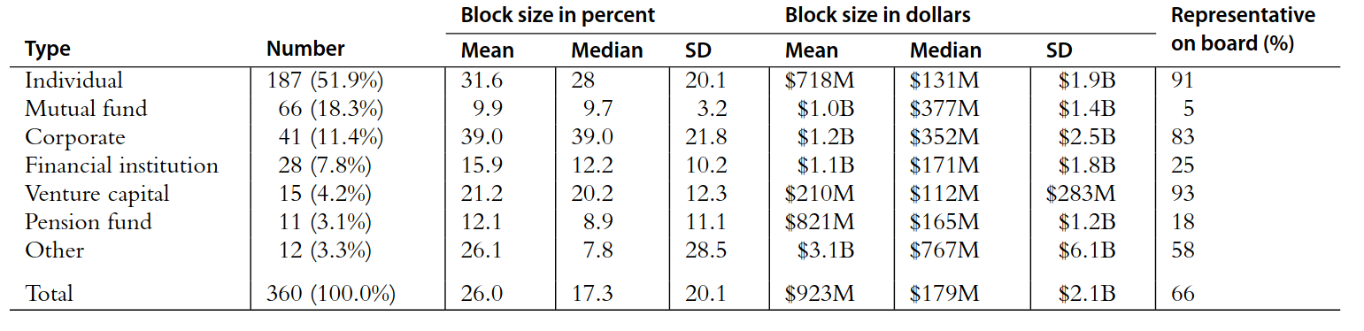
1) Property Rights of Corporations and Blockholders
Type of Blockholders (>5%)
(Edman et al., 2017 )

Slide 9
1) Property Rights of Corporations and Blockholders
Relevant subcategory: Investor Activists:
Activist campaigns are conducted through various methods:
  Proxy Fights: Activists attempt to gain representation on the company's board by persuading other shareholders to vote for their proposed directors.
  Publicity Campaigns: They may publicly criticize management decisions to garner support and apply pressure for change.
  Shareholder Resolutions: Proposing formal recommendations or requirements for management to consider during shareholder meetings.
  Litigation: Initiating legal action to enforce shareholder rights or challenge management practices.
  Direct Negotiations

Slide 10
1) Property Rights of Corporations and Blockholders
The objectives of these campaigns vary but generally aim to:
  Financial Improvements: Enhance shareholder value through strategies like cost-cutting, restructuring, or changes in capital allocation.
  Strategic Changes: Influence corporate strategy, such as advocating for mergers, acquisitions, divestitures, or shifts in business focus.
  Governance Reforms: Improve corporate governance by altering board composition, executive compensation, or management accountability.
  Environmental, Social, and Governance (ESG) Initiatives: Promote sustainable and socially responsible business practices.

Slide 11
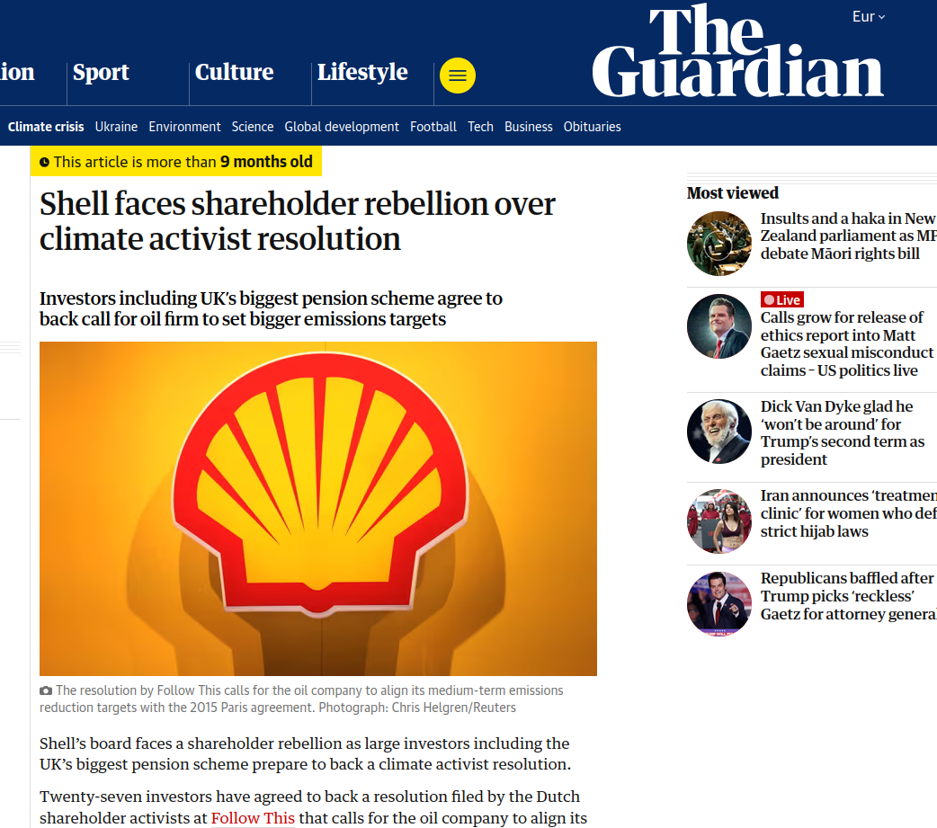
1) Property Rights of Corporations and Blockholders
Shareholders activists

Slide 12

1) Property Rights of Corporations and Blockholders
Shareholders activists
“Earlier this year, the activist investor nominated seven directors to Norfolk's board and urged the company to replace then-CEO Alan Shaw, arguing that new blood was needed to improve financial and operational metrics.”

Slide 13
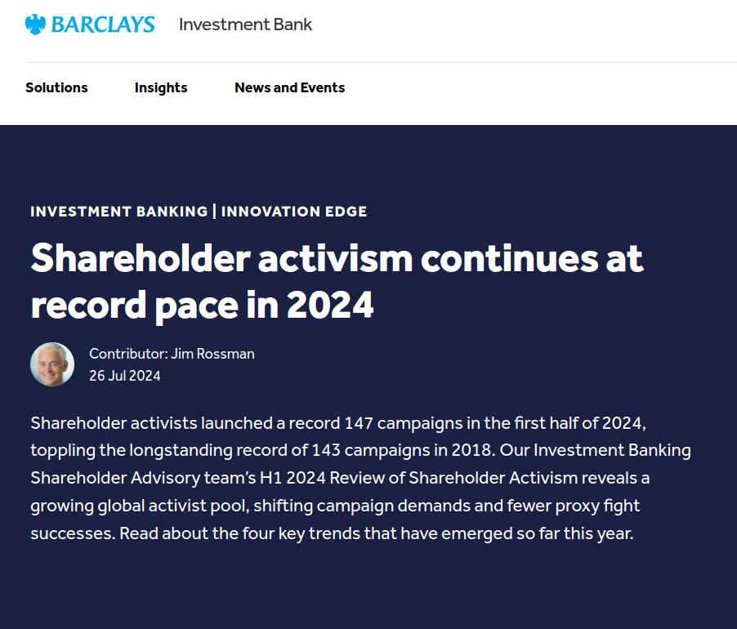
1) Property Rights of Corporations and Blockholders
Shareholders activists

Slide 14
2) The costs of Blockholders
While blockholders help mitigate agency costs, their presence introduces potential conflicts with smaller shareholders:
a) diverse objectives:
  1) Heterogeneity among blockholders, such as differences between activist funds, index funds, and individual investors, can lead to conflicting agendas and governance paralysis.
  2) Inverse influence cost: different blockholders trying to influence managers to use (all) corporate resources to pursue their objectives.
  3) Coordination problem: collective decision making.

Slide 15
2) The costs of Blockholders
b) Private benefits and Tunneling.
  1) Private benefit: using corporate resources for personal use.
  2) Tunneling and related-party transactions: moving profits to their other companies, leaving losses to other shareholders.

Slide 16
2) The costs of Blockholders
c) Entrenchment
  1) Resistance to Change: Long-term blockholders may resist necessary changes in management or strategy, particularly if those changes threaten their influence or personal benefits.
  2) Reduced Board Independence: Blockholders often have representatives on the board of directors, which can lead to a lack of independence and objectivity in board decision-making.

Slide 17
2) The costs of Blockholders
d) Short-Termism
  Focus on Immediate Returns: Some blockholders, especially activist investors, may push for short-term measures (e.g., stock buybacks or dividend payouts) that boost immediate returns at the expense of long-term value creation.
  Exit-Oriented Strategies: Blockholders relying on "exit" (selling their stake) rather than "voice" (direct intervention) can prioritize strategies that increase stock liquidity or price rather than improving underlying firm performance.

Slide 18
2) The costs of Blockholders
e) Market-Level costs
  Reduced Market Liquidity: Large stakes held by blockholders can reduce the tradability of shares, leading to lower liquidity in the market.
  Barriers to Entry: Dominant blockholders may deter potential new investors or management teams, limiting innovation and competition within the firm or industry.

